Slide 1
2022 Annual General Meeting
May 26, 2022

Slide 2
2021 HIGHLIGHTS
Accomplishments
Challenges
Maintained a strong financial position throughout the pandemic
Over $95,000 net fundraising revenue
Over $108,000 cash donations
Rescued/treated 514 cats
411 adoptions
Veterinary capacity is highly constrained
Continued cat overpopulation crisis and pressure from the community to rescue more cats
Potential for volunteer burnout remains

Slide 3
BOARD
Highlights & Challenges
Goals
Strong financial position maintained throughout pandemic
Organization review completed by MNP
Board turnover, expansion, and structural changes
Board structure change implementation
Utilize cash surplus most effectively
Create meaningful impact as part of the Regina Cat Coalition

Slide 4
VOLUNTEER TEAM
Highlights
Challenges
Popular programs in Covid have phased out or diminished – delivery, masks, recycling
Cat beds continue to be available and are made by a volunteer
Turnover in the role has led to reduced focus in certain areas due to reduced capacity (recruitment, appreciation events)
Volunteer co-ordinator is located outside Saskatchewan – no one local
Goals
Recruit a local volunteer co-ordinator
Re-engage with volunteers
Continued focus on pre-screening fosters to assist Pet Rescue with less issues finding fosters and having to transfer cats between homes

Slide 5
FUNDRAISING -
Fundraising numbers
Highlights & Challenges
Goals
$72,000 total - mostly from events
2 partnership fundraisers with local businesses
2 online silent auctions
3 plant fundraisers
2 online 50/50s
Book sales created and ran by volunteers
Online 50/50s generated >$31,000 net funding
Partnership fundraisers help bring business to local small businesses while raising funds
Hesitant to return to in-person events
Fundraising duties are concentrated on a small group of volunteers so can lose momentum
Expand group of fundraising volunteers and recruit a second co-chair
Emerge into the post-Covid environment with fresh ideas for continued success

Slide 6
COMMUNICATIONS
Highlights & Challenges
2 new volunteers to boost social media presence (adoption and fundraising campaign focus)
Supported increases in fundraisers, rescues and adoptions with social media and communications activities
2022 calendar, holiday cards, merchandise (sweaters and t-shirts, cat beds)
Social media followers | Dec. 2021 | Increase from 2020
Instagram | 6,761 | +8%
Twitter | 1,245 | +3%
Ebulletin | 1,284 | +23%
Facebook | 10,354 | +8%
Website | 2021 | Year over year decrease
Page views | 585,000 | -18%
Visits | 110,000 | -27%
Audience size (unique visits) | 61,000 | -29%
Goals
Update adoptions page to implement filters to sort cats
Increase social media presence and gain followers on all platforms
Recruit a co-chair with communications background

Slide 7
PET RESCUE
 | 2021 | 2020
Cats rescued | 514 | 595
Cats adopted | 411 | 541
Sterilizations | 411 | 485
Euthanizations | 17 | 13
Foster homes | 82 | 82
Highlights & Challenges
New foster homes
Partnership with Prezoomably Cats and volunteers at that location
Relationships with partner vet clinics remain strong
Wait lists and reduced capacity at vet clinics is a challenge
Boarding space at Prezoomably remained full year round
Many rescues had complex needs and medical issues this year
Goals
Work with community partners to address root causes of cat overpopulation
Develop a long-term strategy in collaboration with the board to respond to organizational growth

Slide 8
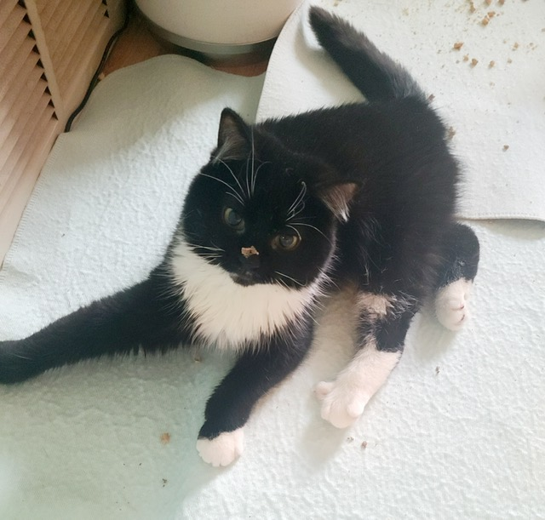
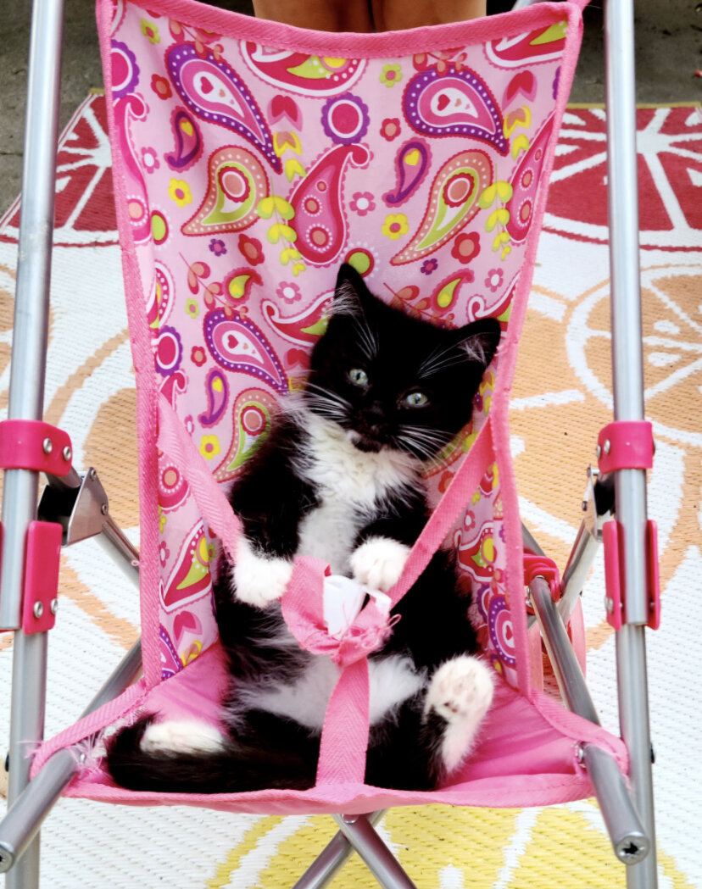
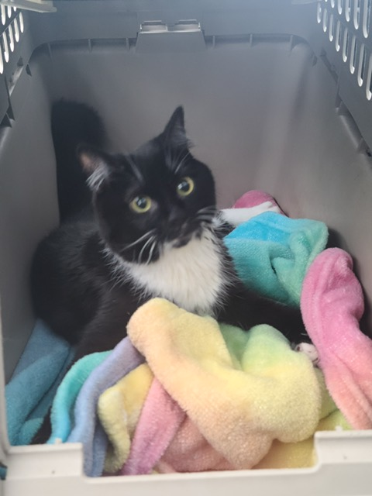
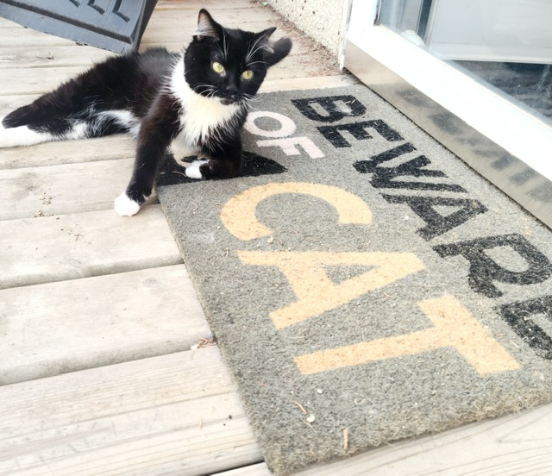
Joi

Slide 9
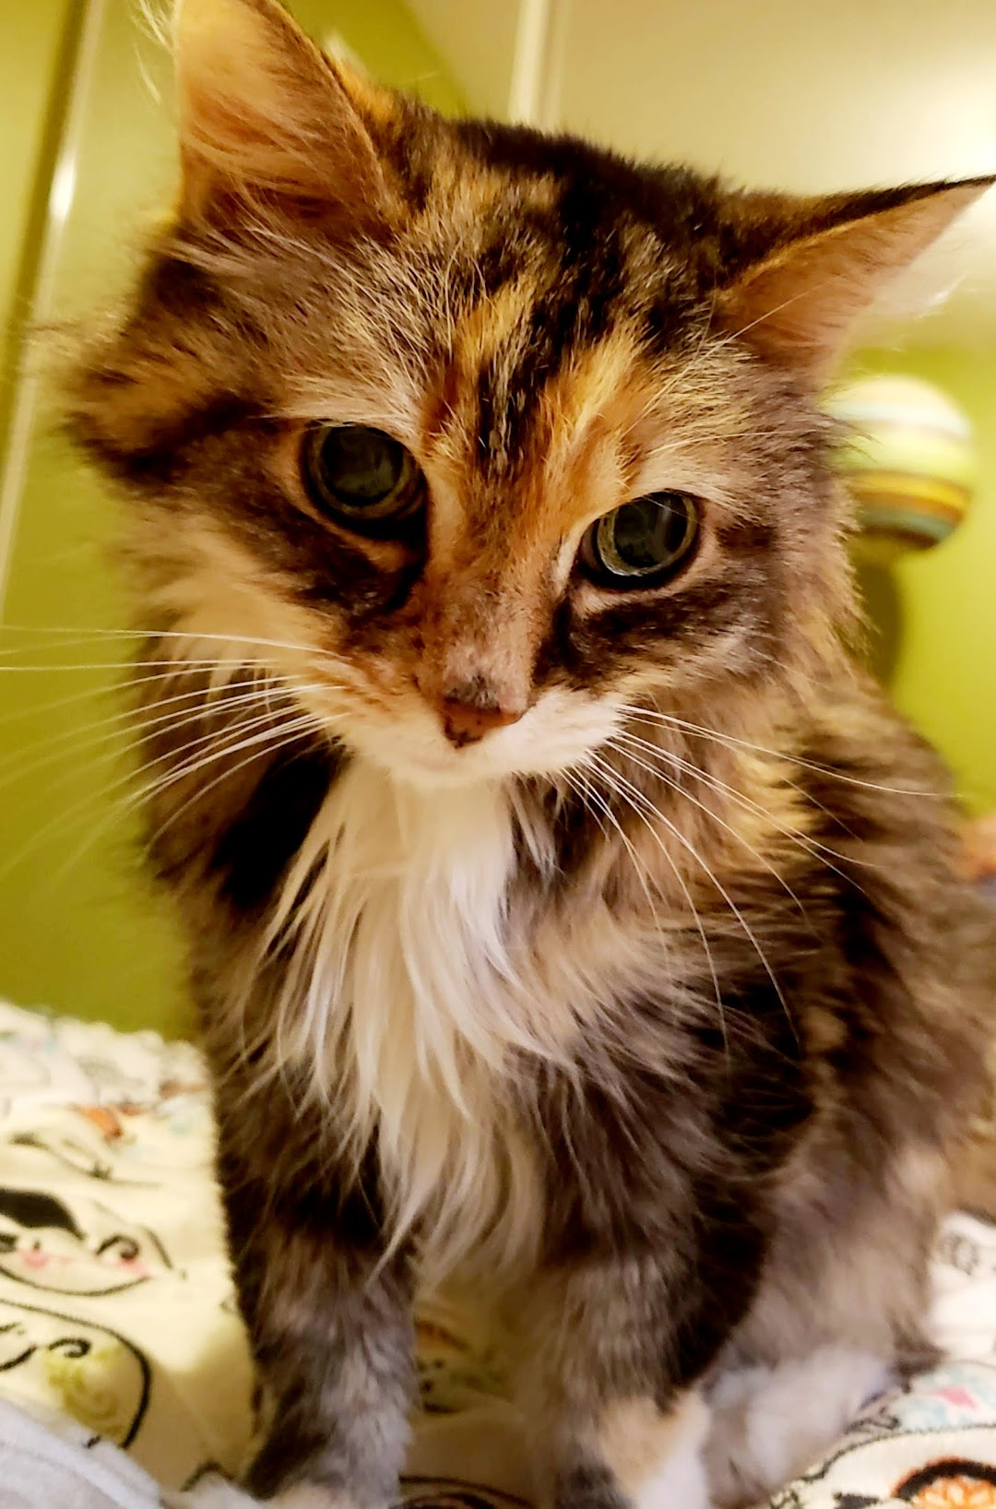
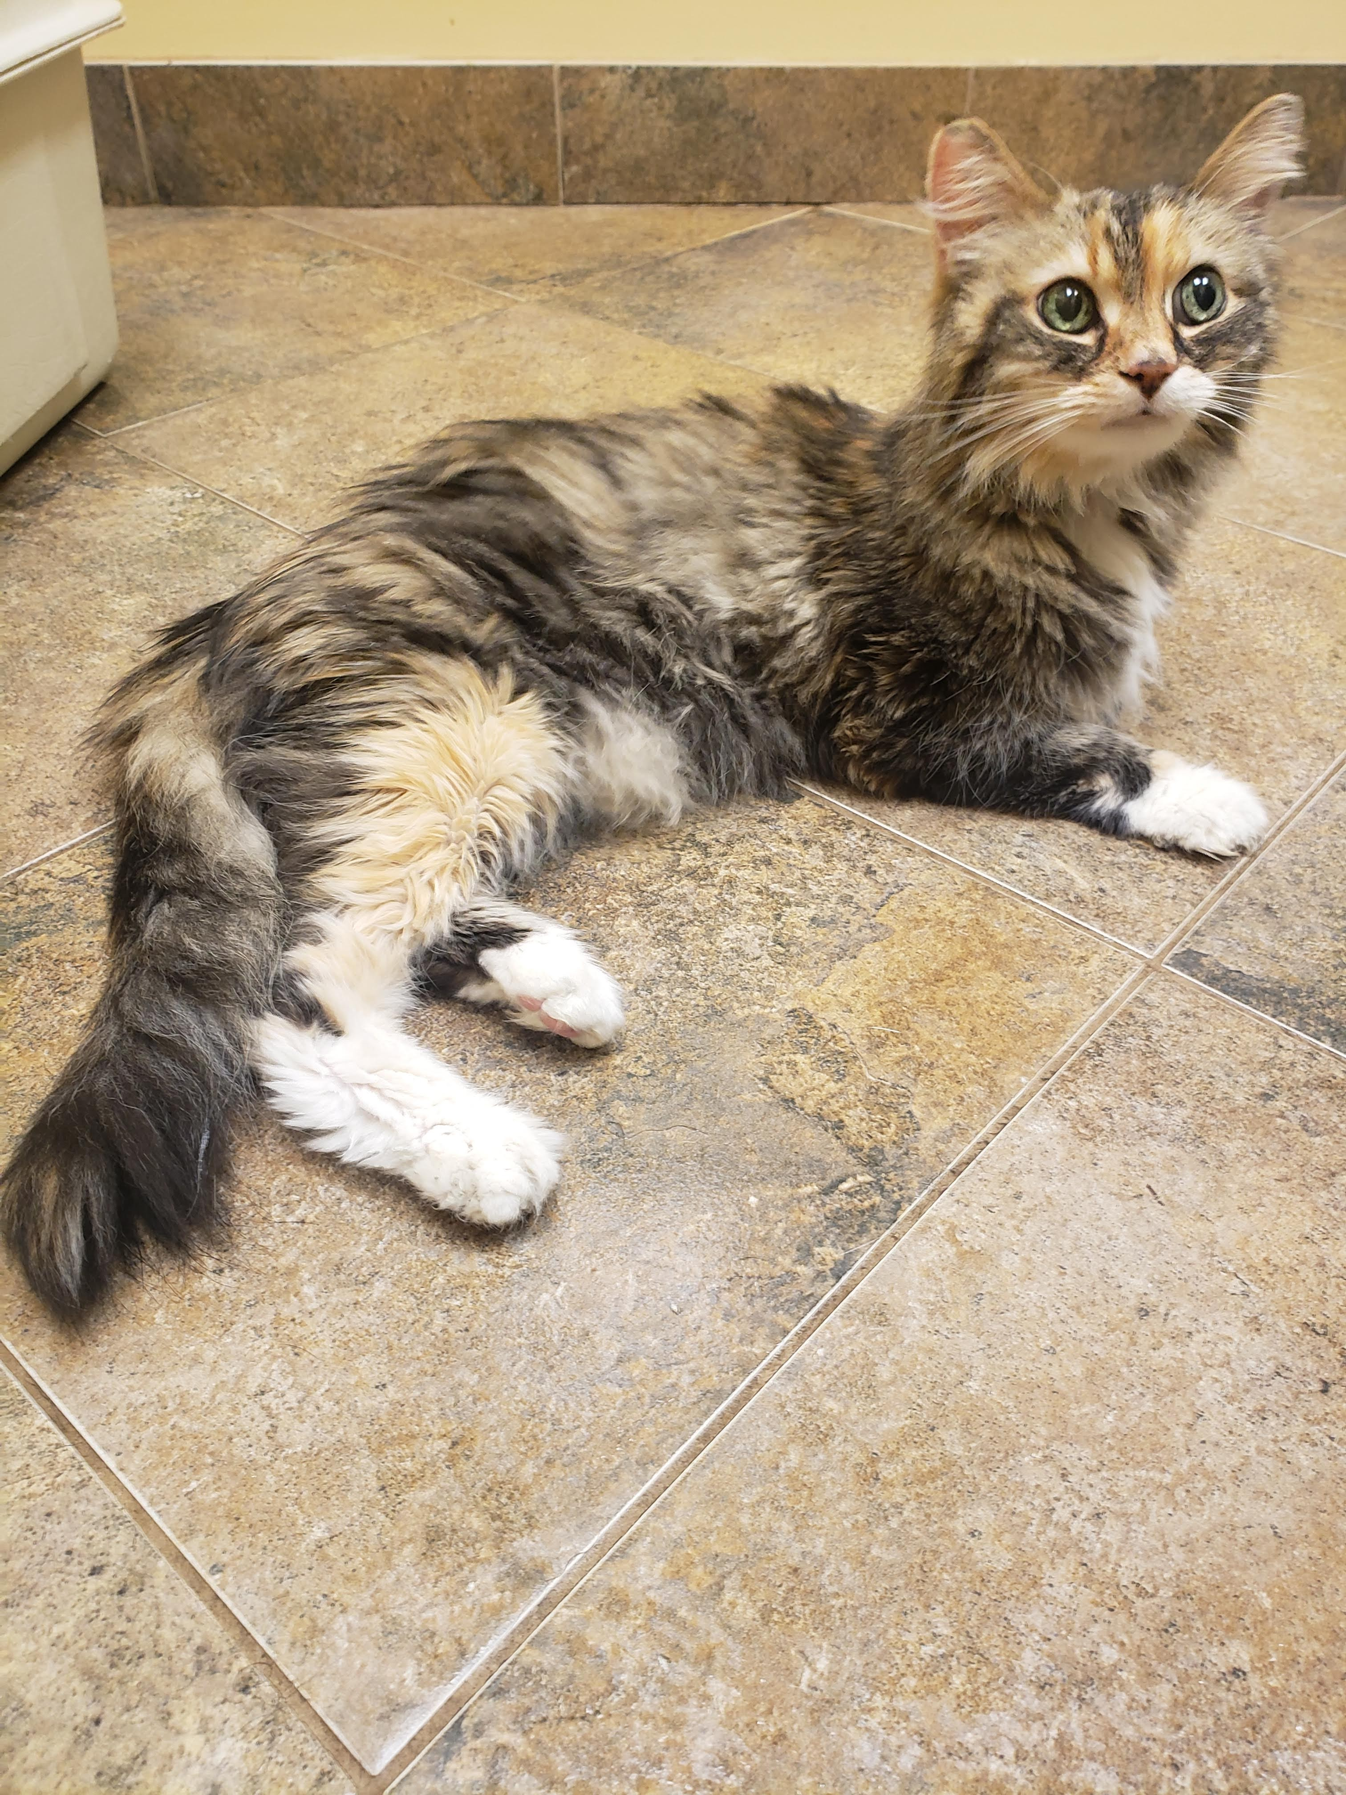
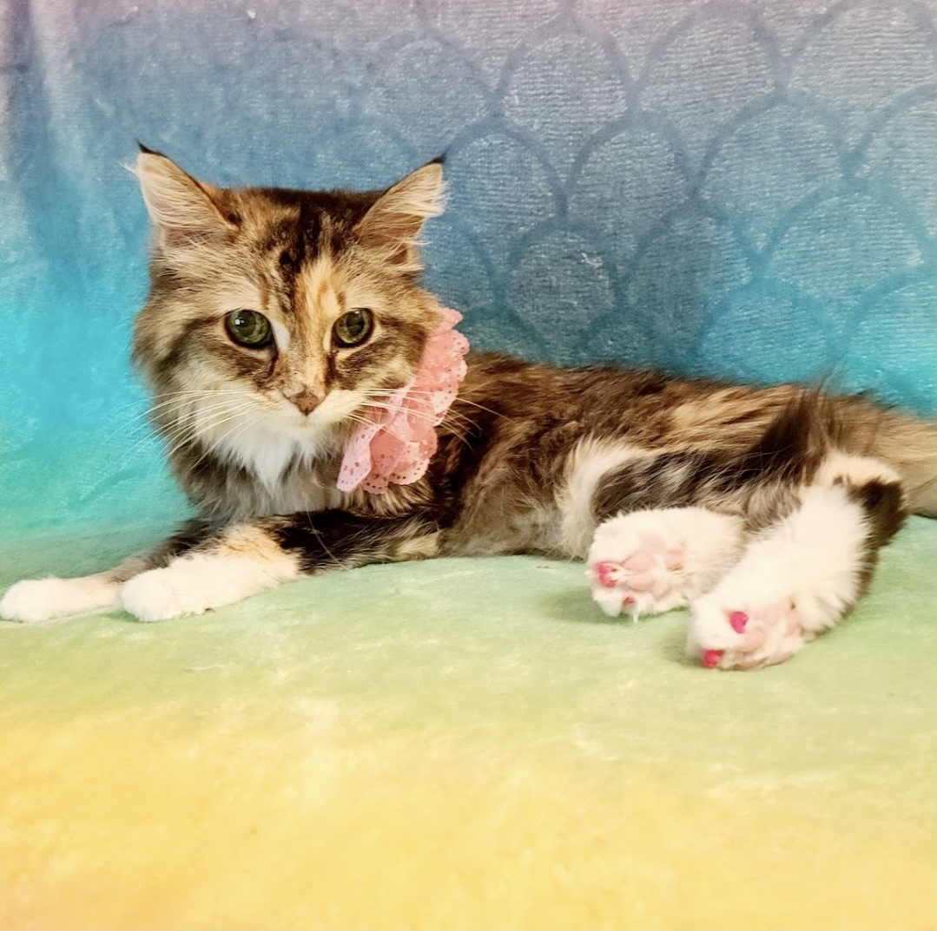
Cassie

Slide 10
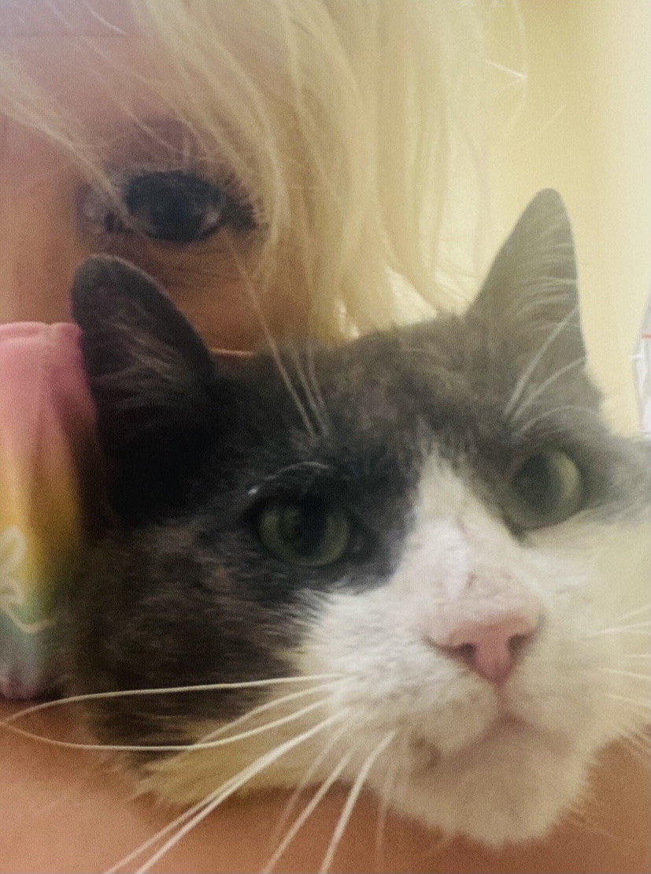
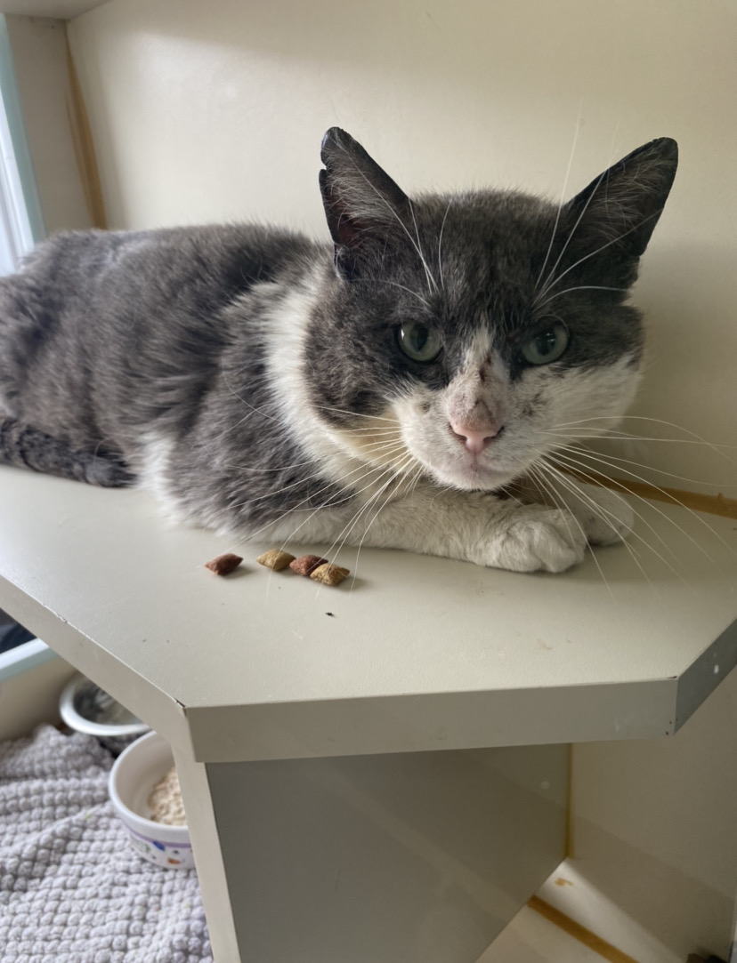
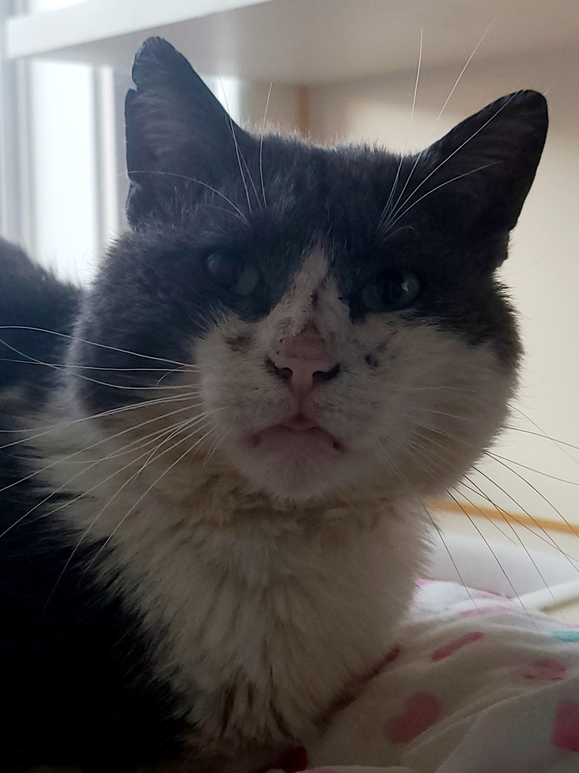
Nixon

Slide 11
COMMUNITY CAT TEAM
28 RCR colonies
47 private citizen colonies
RCR colonies | 2021 | 2020
TNR | 3 | 14
Litters of kittens | 2 | 7
Tame kittens into foster care | 11 | 44
Tame cats into foster care | 12 | 22
Deceased cats | 4 | 6
Highlights & Challenges
6 new volunteers joined community cat feeding team
Made ~100 winter shelters
Rescued 13 kittens and 9 adults from one location
Caught a trap savvy feral female after 2 years and 2 litters of kittens
Limited # of vet appointments on short notice due to Covid restrictions
Other locations | 2021 | 2020
TNR | 6 | 6
Litters of kittens | 6 | 6
Tame kittens into foster care | 28 | 11
Tame cats into foster care | 21 | 8
Deceased cats | 4 | -
Goals
Repair deteriorating feeding stations
Complete more TNR’s at RCR colonies
Secure a location for a garage sale

Slide 12
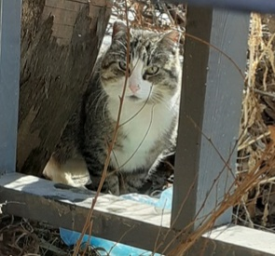
Rest Peacefully Terri

Slide 13
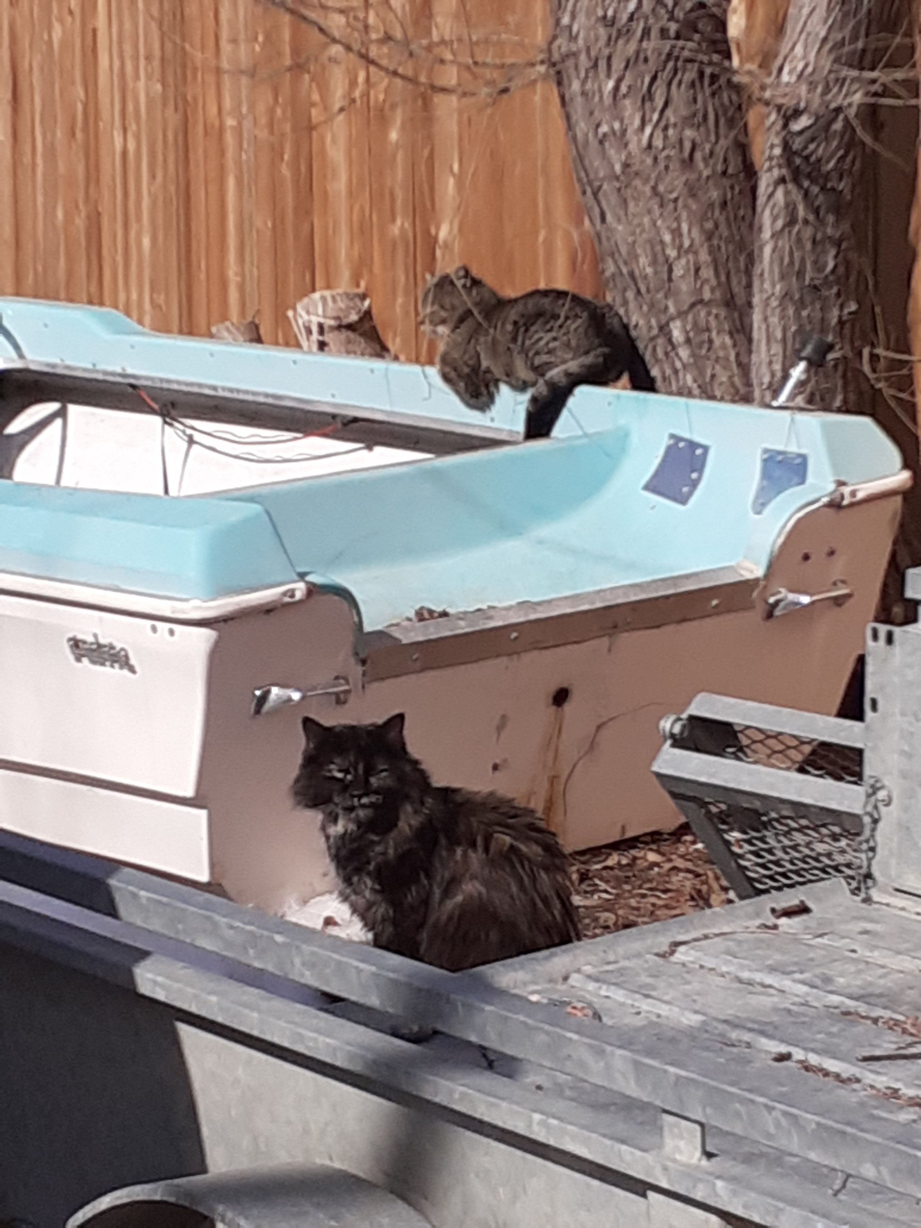
The Elusive Fiona

Slide 14
2022 Annual General Meeting
May 26, 2022

