Slide 1
2023 Annual General Meeting
May 29, 2023

Slide 2
Vision: All Cats in Regina are cared for and valued
Mission: To care for cats from Regina’s streets through sterilization, facilitating adoptions and promoting responsible pet guardianship
Values:
Compassionate: We have compassion for and commitment to abandoned and community cats in Regina.
Responsible: We make decisions based on realistic outcomes after careful consideration.
Respectful: We are open to new ideas and participate in respectful dialogue.
Ethical: We are transparent, honest, accountable and fiscally responsible. Our volunteers are knowledgeable and ethical.
Collaborative: We work with organizations and members of the public to develop and implement positive outcomes.

Slide 3
2022 HIGHLIGHTS
Accomplishments
Challenges
440 cats rescued
376 cats adopted
16 cats added to our Community Cats program
Over $50K net fundraising revenue
Over $120K cash donations
New 3 year strategic plan
High levels of volunteer turnover and difficulty recruiting new volunteers
Veterinary capacity is highly constrained
Loss of Prezoomably boarding facility
Intake freeze due to increased cat overpopulation crisis and more surrenders
Inflation/costs have increased

Slide 4
BOARD
Highlights & Challenges
Goals
New 3-year Strategic Plan
Strong financial position, though back to pre-COVID revenues
Documented some key roles
High board turnover making implementation of strategic plan difficult
Permanent Operations Manager in place
Implementation of strategic plan
Board recruitment and succession planning for stability
Engage new community organizations/partnerships
Trauma-informed training

Slide 5
Strategic Goals
Stability & Sustainability
all cats we rescue find loving homes quickly, our programs are effective, our volunteers feel engaged and valued, and that we are fiscally responsible to support our operations.
Data Driven Decision Making
Stabilizing Operations
Improving Work Environments (Operations Manager)
Community Relationships and Education

Slide 6
VOLUNTEER TEAM
Highlights
Challenges
Core, passionate team of volunteers
40 people volunteered for at least 1 Mosaic event
Fun cat beds made by a volunteer
Bringing on new fosters after initial interest
Last minute recruiting for Mosaic events; relying on the same people
Volunteer co-ordinator in 2022 located outside Saskatchewan – no one local
Goals
More active recruitment strategies for Mosaic volunteering
Clean up the volunteer role descriptions on the website
More volunteer engagement events
Continued focus on pre-screening fosters to assist Pet Rescue with less issues finding fosters and having to transfer cats between homes

Slide 7
FUNDRAISING
Fundraising numbers
Highlights & Challenges
Goals
~$ 57K net total - mostly from events
Online silent auction (7K)
2 plant fundraisers (21K)
In Good Taste (5K)
Clothing/Calendars (5K)
Mosaic $25K
Book sales created and ran by volunteers - $6.7K
Book sales are big success
Focus is on the most profitable events with reasonable work (50/50’s, OSA’s)
Fundraising duties are concentrated on a small group of volunteers so can lose momentum
Poorly managed events due to low volunteers can lead to more frustration and drop out
Expand group of fundraising volunteers by 2-4 who will take on more of a leadership role for specific events
More administrative support
Have more community engagement fundraising events

Slide 8
COMMUNICATIONS
Highlights & Challenges
Increased social media/engagement since August 2022
More posts focused on education, long-term fosters and following up on adopted cats
Supported increases in fundraisers, rescues and adoptions with social media and communications activities
Great teamwork with other RCR areas
Social media viewers | 2022 | Change from 2021
Instagram | 53,153 | +17.5%
Facebook | 211,037 | +32.5%
Social media likes/follows | 2022 | Change from 2021
Instagram | 299 | +44.4%
Facebook | 867 | +80.6%
Goals
Website improvements - cat-a-logue
Behind the scenes RCR work
Recruit more comm’s volunteers including media and education specialist
Get more feedback to see if strategies are working
Website Traffic | 2022 | Change from 2021
New visits | 585,000 | -5%
All Visits | 104,000 | -13%

Slide 9
PET RESCUE
 | 2021 | 2022
Cats rescued | 514 | 440
Cats adopted | 411 | 376
Euthanizations | 17 | 20
Foster homes | 82 | 71
Highlights & Challenges
Received large donations of food and litter
Some great recruits but not enough foster homes to meet demand led to intake freeze
Lots of complex medical cases
Prezoomably Cats facility no longer available
Relationships with partner vet clinics remain strong but wait lists and reduced capacity at vet clinics is still a challenge
Goals
Improve supply management
Work with board to search for appropriate boarding facility
Recruit new volunteers/expand roles
Work with community partners to address root causes of cat overpopulation

Slide 10
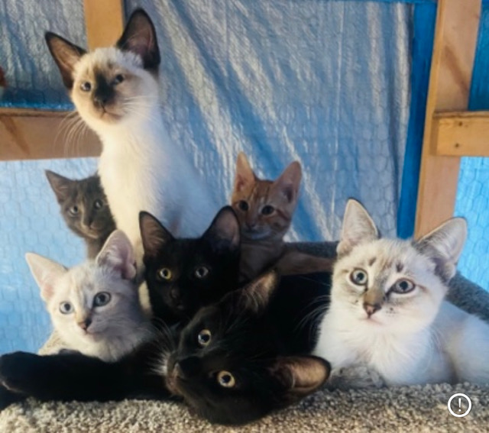
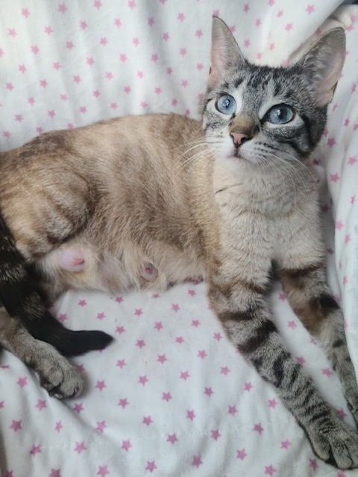
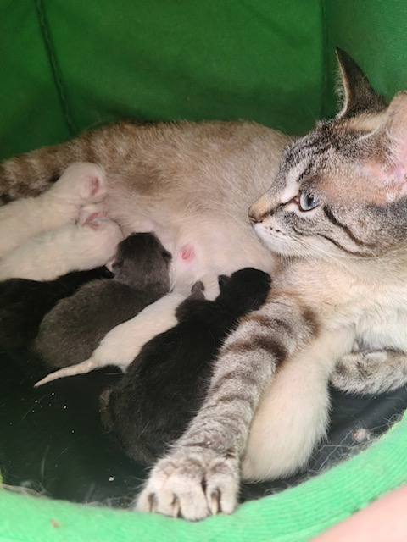
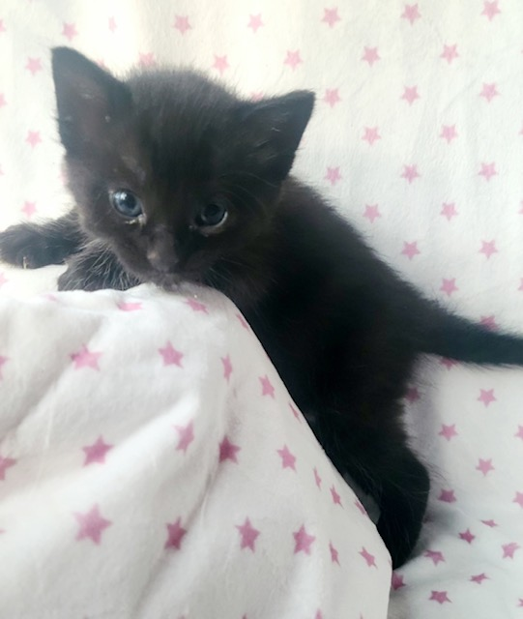
Rinata
Notes:
Pictured here is Rinata just shortly before giving birth to 10 kittens. Yes 10!
Rescued from north central this beautiful Mama of only 10 months was on her 3rd litter of kittens (2 litters before rescue).
Sadly a couple of her kittens did not make it (due to such a big litter) but this Beautiful Mama went on to be called “Mom of the year” taking on another kitten who’s Mom and siblings had passed away.
She was the most loving, attentive mother we have ever met staying with all her babes until she found a furrever home of her own❤️

Slide 11
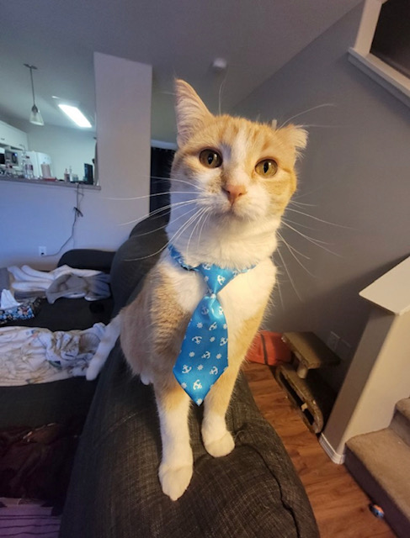
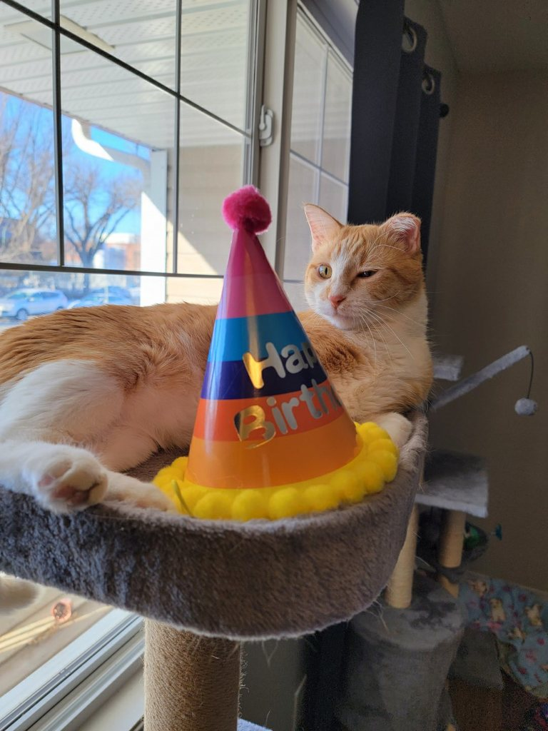
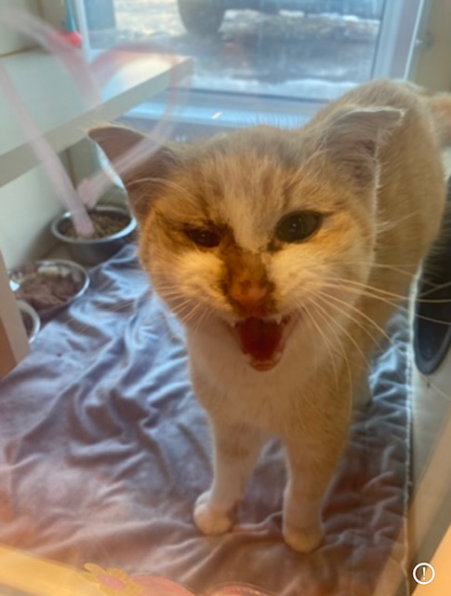
Kendrick
Notes:
Kendrick
~ this darling soul came into care early in 2022 in the cold of winter
~ we were contacted by a concerned citizen when Kendrick showed up on their property cold, hungry and looking rough
~ we knew we had to help this poor fellow (it was Connie / Prezoomably owner neighbour that contacted) so it was in the country just outside of the city. It was thought to be Kendrick may have been dumped on the property.
~ we got him cozy at Prezoomably where we nursed him back to health after several vet visits
~ Kendrick had endured so much. He was frost bitten, emaciated (weighing only 3 pounds at a year and a half of age) and was struggling with a bad case of upper respiratory virus
~ after several weeks he was moved into foster care where his loving foster continued to care for him. While it took some time for Kendrick to heal he was eventually put up for adoption and got a wonderful home where to this day he is so adored
~ Kendrick is featured in RCR’s 2023 calendar
The adopters had this beautiful mat made for him that I think is so precious!
Kendrick just celebrated his birthday (photo below).

Slide 12
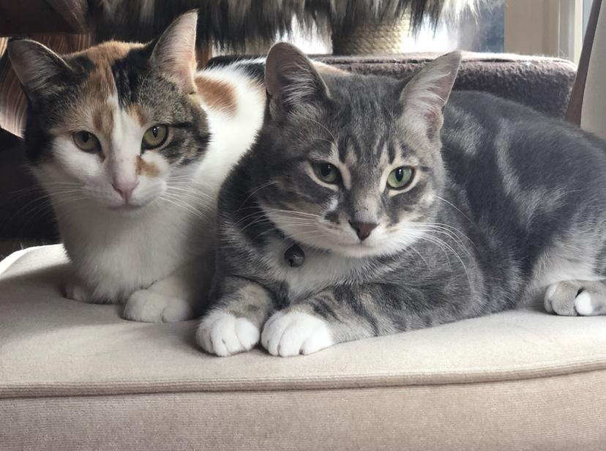
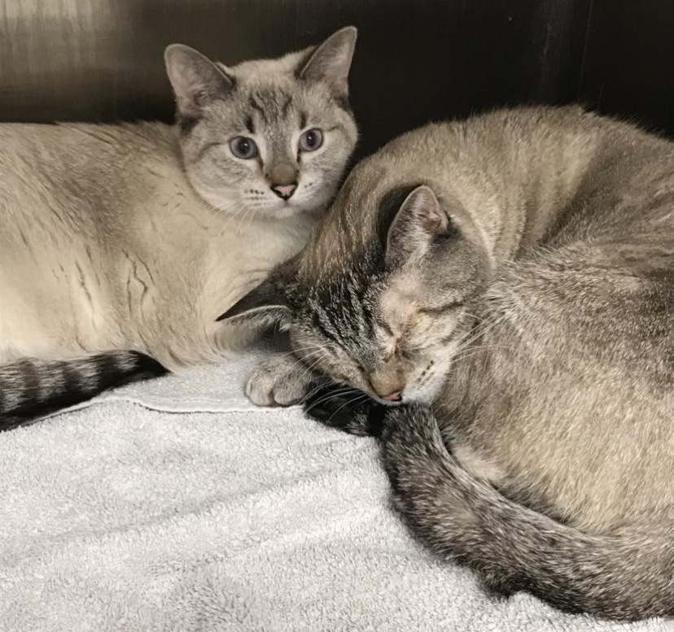
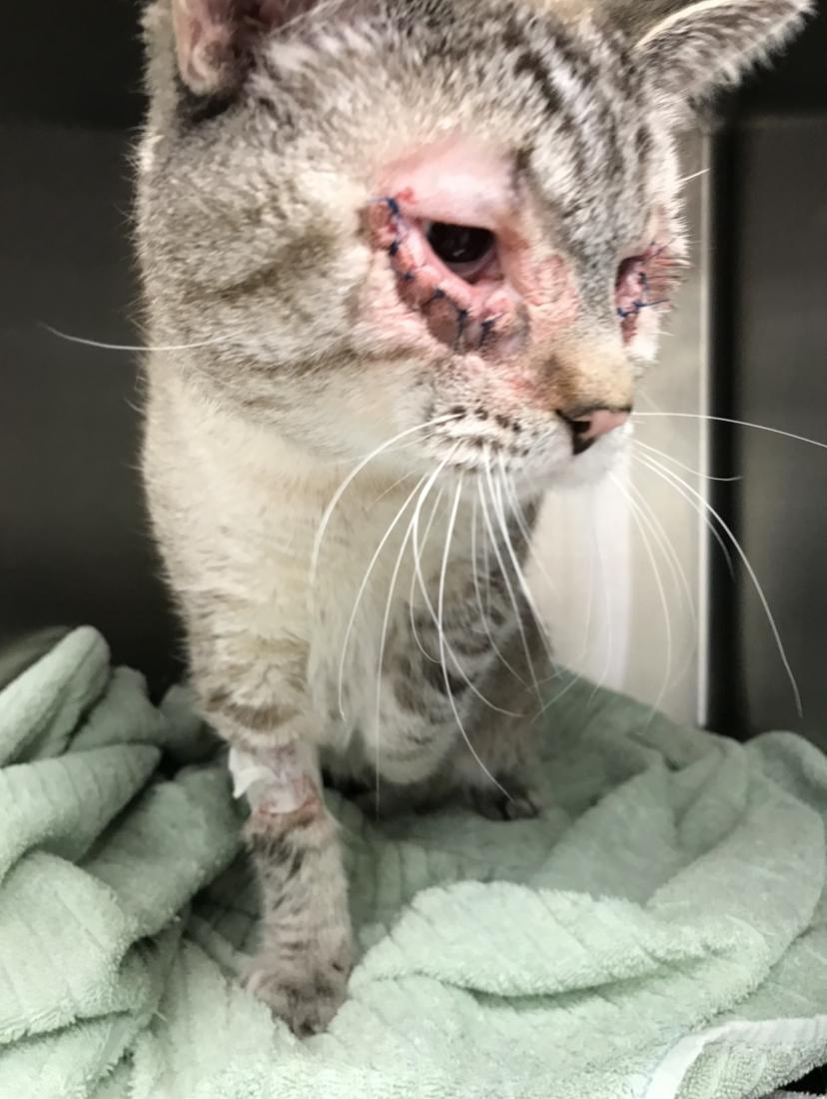
China & Abba
Catrina & Jonah
This mother and daughter duo came into care after spending time living stray in the country. Being very wary of humans, lots of time was put into this special pair. They were adopted together into a loving home.
This special father-daughter duo came into care while living in the backyard of a kind samaritan who reached out for help on their behalf. After entropion eye surgery for dad (Jonah) they were finally ready for their forever home. They were fallen in love with and they found it together.
Bonded Pairs
After successful entropion eye surgery.

Slide 13
COMMUNITY CAT TEAM
31 RCR colonies
44 private citizen colonies
RCR colonies | 2021 | 2022
TNR | 3 | 6
Litters of kittens | 2 | 2
Tame kittens into foster care | 11 | 6
Tame cats into foster care | 12 | 17
Deceased cats | 4 | 4
Highlights & Challenges
4 new volunteers joined community cat feeding team
Made ~75 winter shelters
One of our biggest challenges continued to be a lack of vet appointments on short notice due to the shortage of veterinarians and volunteers for the community cat feeding
Other locations | 2021 | 2022
TNR | 6 | 10
Litters of kittens | 6 | 0
Tame kittens into foster care | 28 | 12
Tame cats into foster care | 21 | 12
Deceased cats | 4 | 0
Goals
Repair deteriorating feeding station and work on securing new ones
Complete more TNR’s at RCR colonies
Secure a location for a garage sale (e.g. new facility)

Slide 14
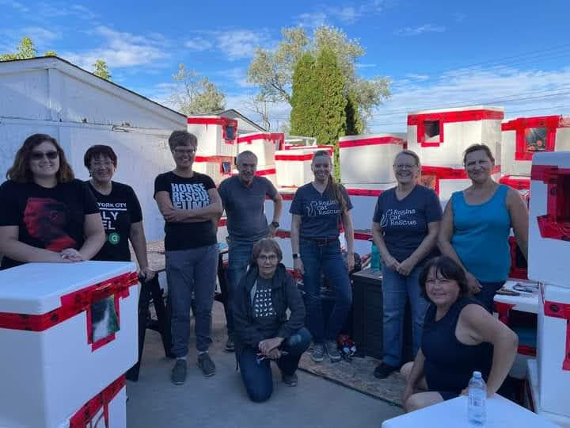

Slide 15
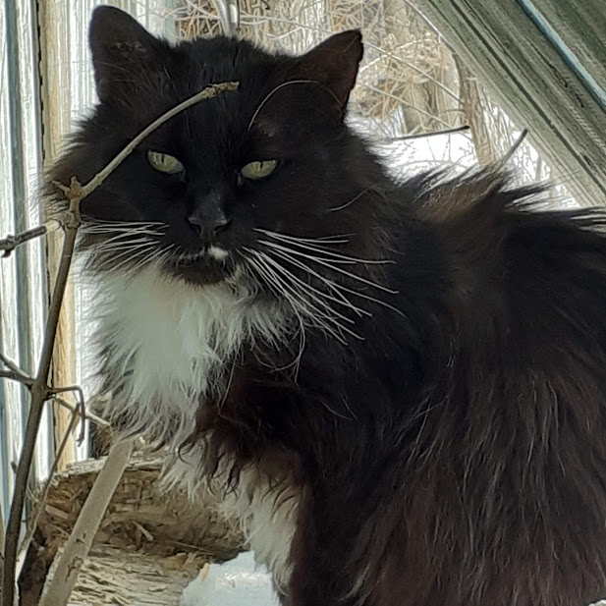
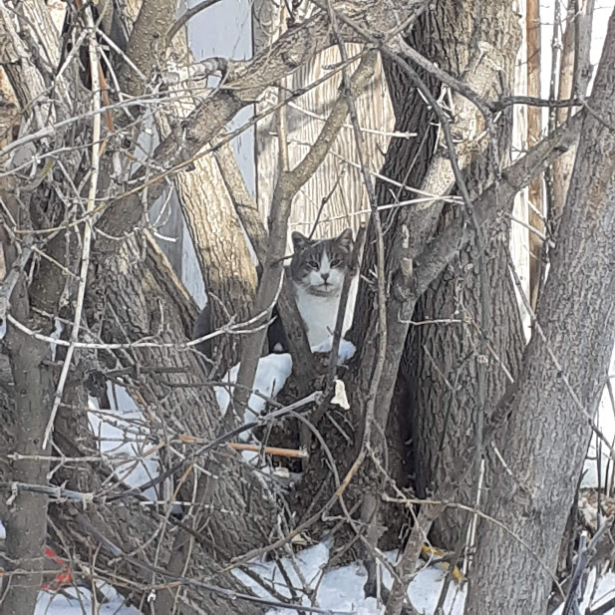
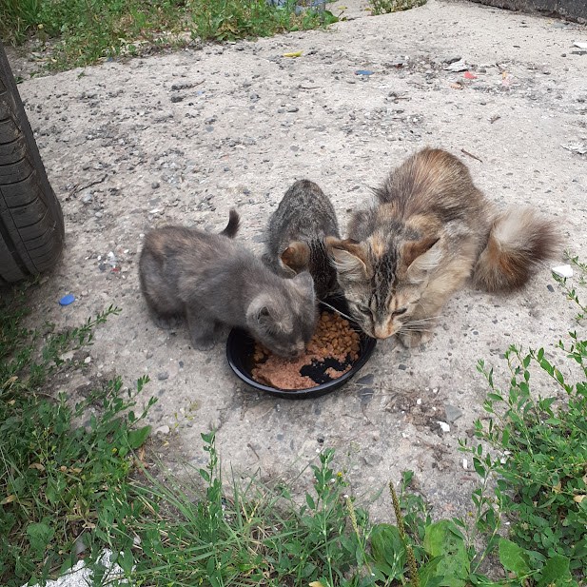
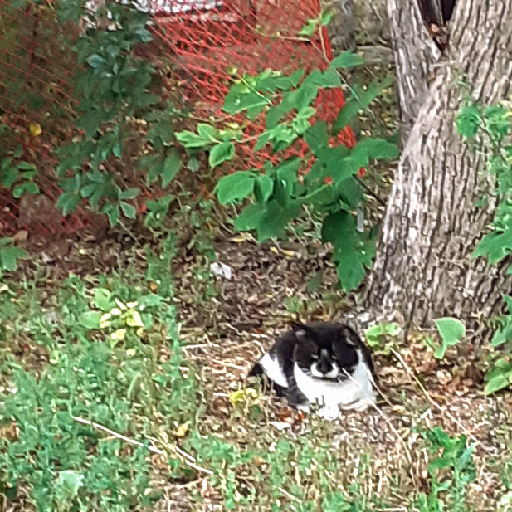
OUR COMMUNITY CATS
Chris
Mickey
Abe
Tina & Kittens

Slide 16
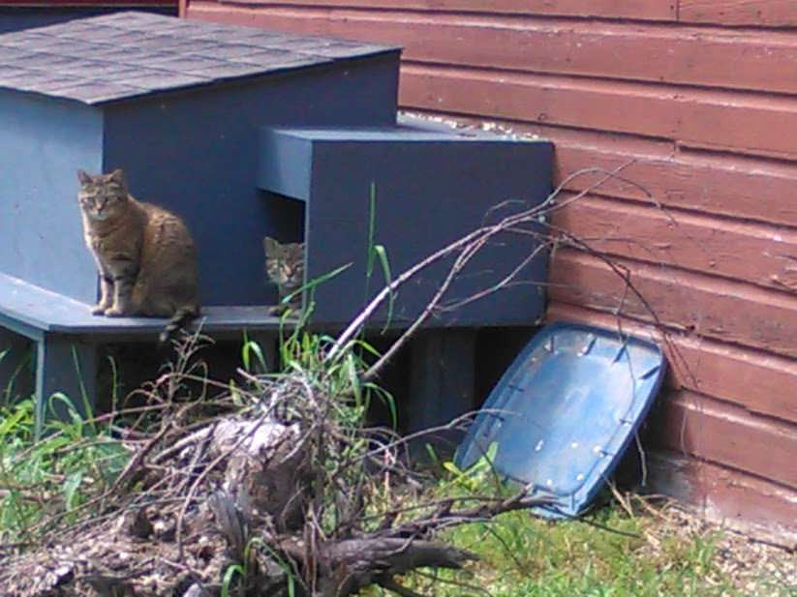
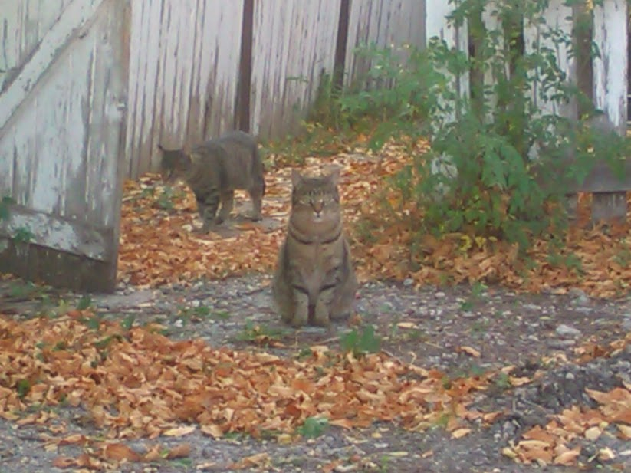
Goodbye Melaina and Makayla
Notes:
They were one of our feeders favorites as they were generally always around waiting for their wet food they knew they would get when the feeders came each day. They appeared to be healthy 9 year old cats, so it's sad and shocking that they both suddenly disappeared. Despite efforts to search the block and ask residents there was never any sign of them. They are gone but not forgotten.

Slide 17
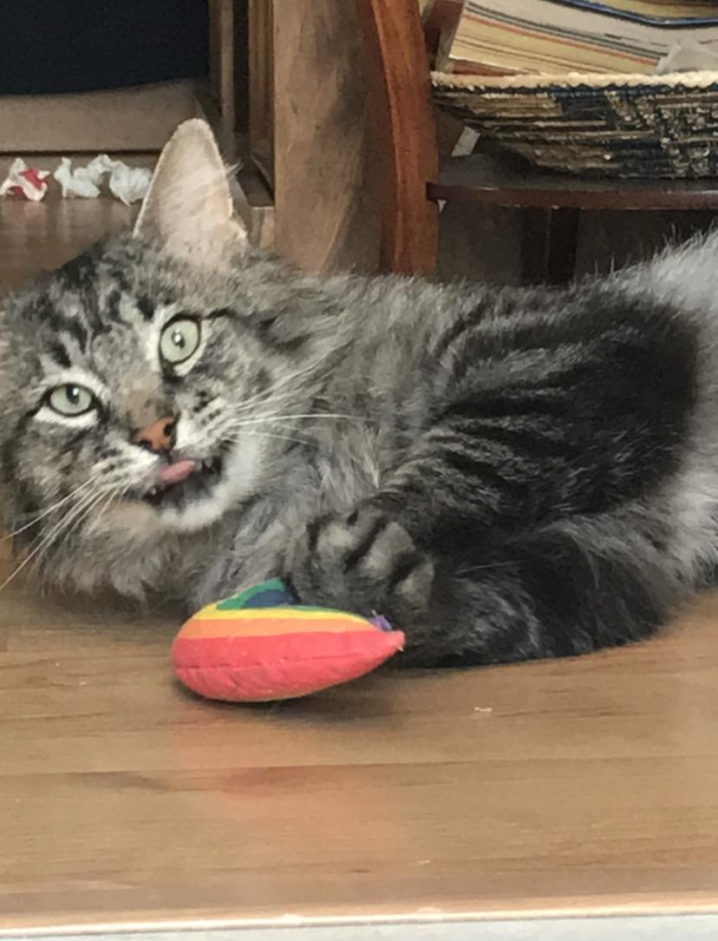
Thank you from the bottom of our hearts!
You have helped to make a difference for so many cats and kittens
James (above) is smiling all the way to his furrever home!

Slide 18
2023 Annual General Meeting
May 29, 2023

